Slide 1

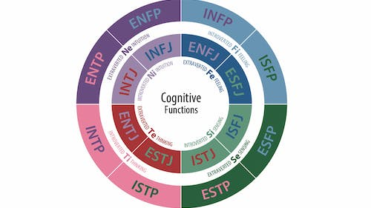

MBTI PERSONALITY PREDICTION
Analysis and Prediction
Github Repo: https://github.com/Darsangmdd/AML-project
Group 9
Members:
Varalika Mahajan (vm2695)
Vrinda Bhat (vgb2113)
Meghan Shah (ms5767)
Vibhu Krovvidi (vk2500)
Dhivyadarsan G M (dg3233)
APPLIED MACHINE LEARNING

Slide 2

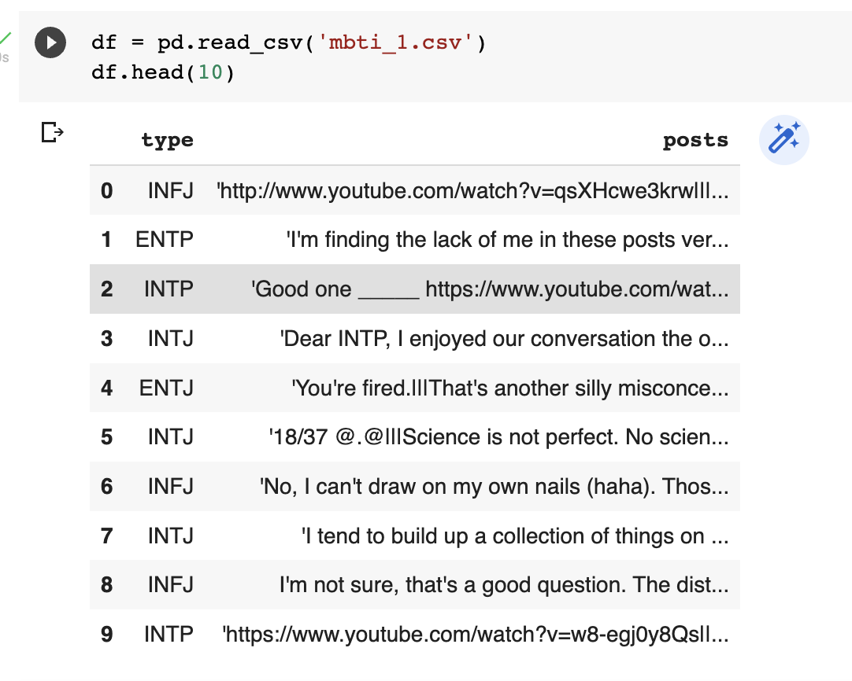
Dataset Details
https://www.kaggle.com/datasets/datasnaek/mbti-type
The dataset provides 8675 unique text entries (2 columns - Personality type & posts) along with an associated MBTI type for the user.
The 16 unique MBTI types are a combination of:
Raw Data Preview:
Introversion (I) | Extroversion (E)
Intuition (N) | Sensing (S)
Thinking (T) | Feeling (F)
Judging (J) | Perceiving (P)
Our project’s objective is to classify posts into MBTI types
‹#› | MBTI Personality Analysis and Predictions

Slide 3
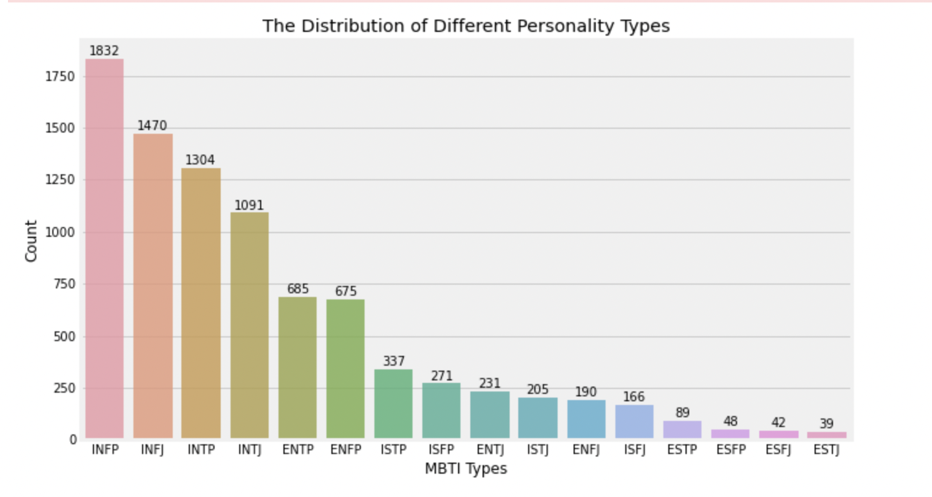
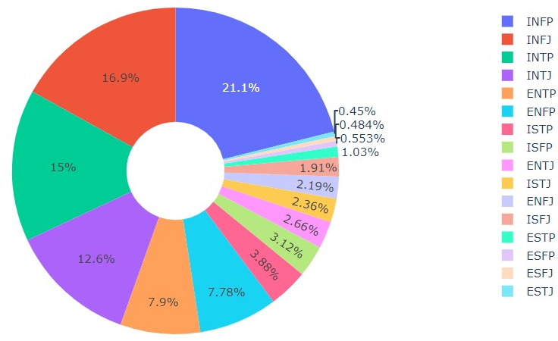
Exploratory Data Visualization - Distribution of Target Variable
From the pie chart and the bar chart we can infer that the dataset is imbalanced i.e. we do not have equal data points (posts in our case) for every personality type.
‹#› | MBTI Personality Analysis and Predictions

Slide 4
Preprocessing Pipeline
Step 1:
Convert text to lowercase
Step 2: Remove special chars
Step 3: Remove Stop Words
Step 4: Lemmati-
zation
Step 5:
Word Embedding
Remove URLs, numbers, symbols, extra spaces etc
Eg:
“i can’t watch9 www.xyz.com”
→ “i cant watch”
Eg:
“This is Great” → “this is great”
‹#› | MBTI Personality Analysis and Predictions

Slide 5
Preprocessing Pipeline
Step 1:
Convert text to lowercase
Step 2: Remove special chars
Step 3: Remove Stop Words
Step 4: Lemmati-
zation
Step 5:
Word Embedding
Remove repeated words with little meaning from string
Eg:
“this can be exhaustive”
→ “can be exhaustive”
Simplify word forms into a consistent word group
Eg:
“studying studies study”
→ “study study study”
‹#› | MBTI Personality Analysis and Predictions

Slide 6
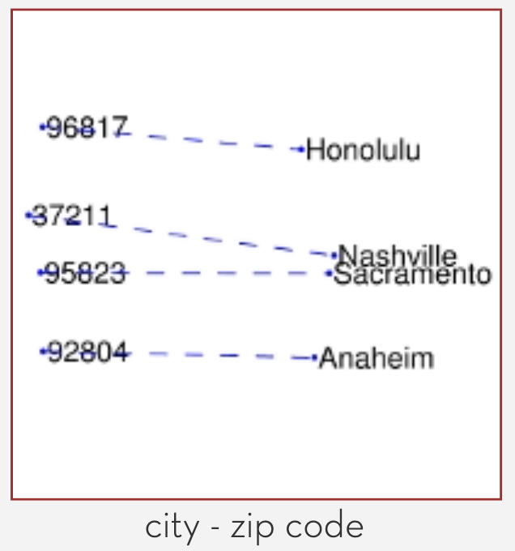
Preprocessing Pipeline
Step 1:
Convert text to lowercase
Step 2: Remove special chars
Step 3: Remove Stop Words
Step 4: Lemmati-
zation
Step 5:
Word Embedding
ML models cannot interpret strings for modellings, thus embedding words as numbers is essential. We used GloVe.
GloVe (Global Vectors) is a pre-trained word vector library by StanfordNLP. It determines mappings between words and vectors such that words with similar meanings occupy similar vector spaces.
For each row, we try to map each word to a GloVe vector and add that to the dataframe. If a word does not exactly map, we ignore it.
GloVe vectors
‹#› | MBTI Personality Analysis and Predictions

Slide 7
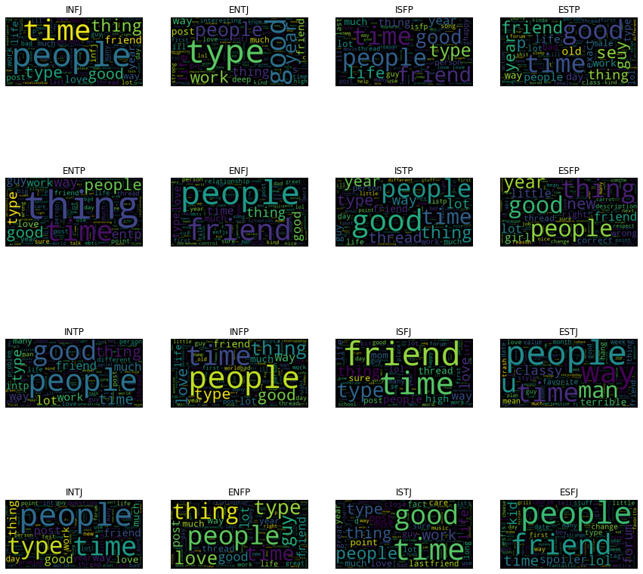
Exploratory Data Visualization - WordCloud Analysis
Wordcloud generation is a data visualization technique used for representing text data in which the size of each word indicates its frequency or importance.
Significant textual data points can be highlighted using a word cloud. By generating a word cloud for each MBTI type, we can see that different personality types emphasize different words or attributes.
For example:
‘People’ is the most used word for ENFJ, ESTJ, INFJ, INTP etc, but not for ISTJ, ENTP, ESTP etc.
Insights:
It would hence be necessary to clean the dataset by removing these MBTI words from each of them as part of our pre-processing stage, before training the model for better evaluation results. These words could contribute noise, making it tougher for models to differentiate MBTI types.
‹#› | MBTI Personality Analysis and Predictions

Slide 8
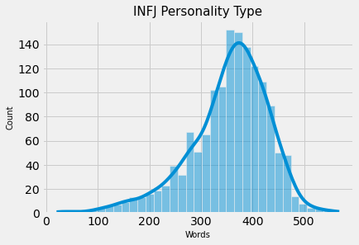
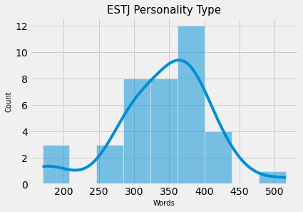
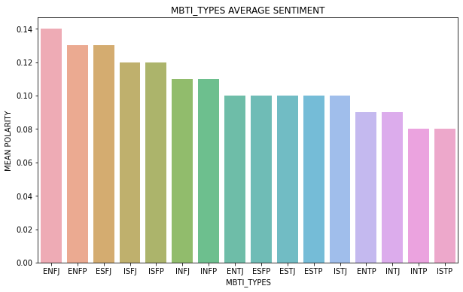
Exploratory Data Visualization - Insights
Different personality types also tend to have different distributions of word counts. This would suggest that word count and character count are also useful variables to consider when building a classification model as they could contribute predictive power. At the same time, we should ensure for the models that we do not allow multicollinearity to occur with respect to the word vectors.
Using the textblob package, we also performed sentiment analysis on the posts. We observed differences across personality types and sentiment scores as seen in the bar chart to the right. This could also be added as an independent variable when training the classification models.
‹#› | MBTI Personality Analysis and Predictions

Slide 9
Machine Learning techniques
Our problem is now translated into a supervised learning task where we use word vectors to classify the MBTI type each post belongs to. To assist, we will use One-versus-One and One-versus-Rest strategies.
To solve the problem, we can use several ML techniques including Multiclass Logistic Regression, Random Forest, SVMs, Neural Networks etc. We offer a rationale for a few of these methods below:
Random Forest Classifier - This method enhances the performance and controls overfitting of the decision tree classifier by fitting many decision trees to sub-samples of the data and then averaging them to get a random forest. Using ensembling, this method also offers useful ways of avoiding overfitting and high dimensionality.
Support Vector Classification - SVC is a supervised algorithm that uses kernel tricks to transform the data to a higher dimension and then find the optimal boundaries based on these transformations. SVCs allow for a soft-margin version that allows some errors as a tradeoff for better overall classification.
Neural Network Classification - NN classification relies on layers of neurons which learn patterns in the data through error back-propogation. NNs tend to capture complex relationships better, which could lead to a boost in performance.
‹#› | MBTI Personality Analysis and Predictions

Slide 10
Future Work and Conclusion
Future Work:
In our future efforts to improve the model, we want to perform the following steps:
Currently, we are using pre-trained GloVe model. We can train the word vectorization model using Word2Vec on our own dataset for better results. This will also ensure we don’t skip words not recognized in GloVe.
We can perform stratified random sampling when splitting the dataset to address imbalanced data. We can also use undersampling/oversampling/SMOTE to create class parity.
Metrics to be used to determine the performance of the model. We are currently proposing an F-1 Score.
Conclusion:
Being able to detect personality of an individual through their readily available social media posts can be a game changer for so many industries. The MBTI dataset provides variety of training data which we will utilize and apply multiple machine learning models to in order to achieve high accuracy and precision.
‹#› | MBTI Personality Analysis and Predictions

